Slide 1

Analytics
Group One: Jimmy Cowden, Hayden Jackson, Dianna Rivera
Chase Scarboro, Alysa Schoenfelder

Slide 2


Introduction to Dataset
1,000,000 Songs
19 Attributes
2010 - 2023
Popularity Score Index:
0-100
Most impacted by recent stream count
Save Rate
Skip Rate
Share Rate
No. of Playlists

Slide 3
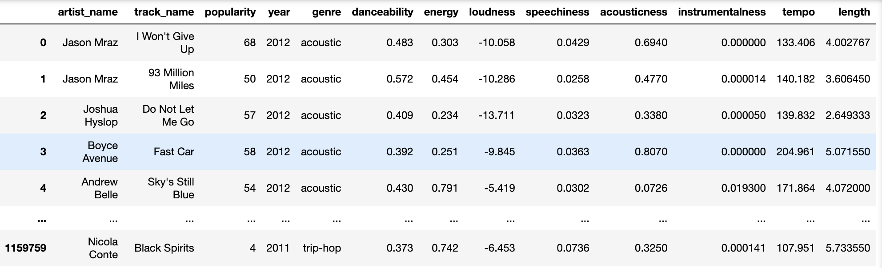
Cleaned Data

Slide 4
Questions
one
What is the relationship with genre and popularity?
two
What is the relationship between average popularity and release date?
Do any attributes effect a songs popularity?
three
Do specific attributes affect a songs popularity score?

Slide 5
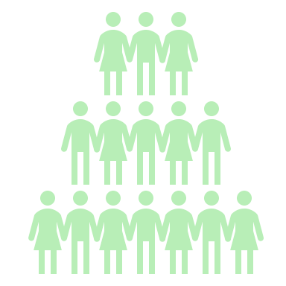

Question One: What is the relationship between genre and popularity?
What are the most popular genres?
What are the least popular genres?

Slide 6
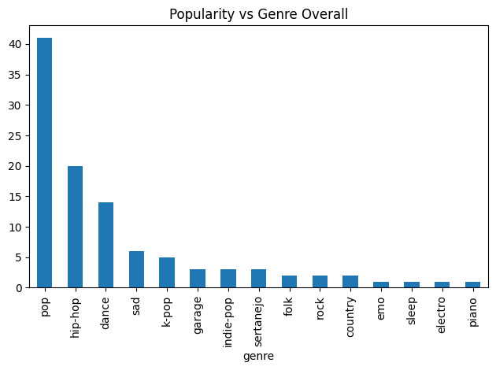
Q1.

Slide 7
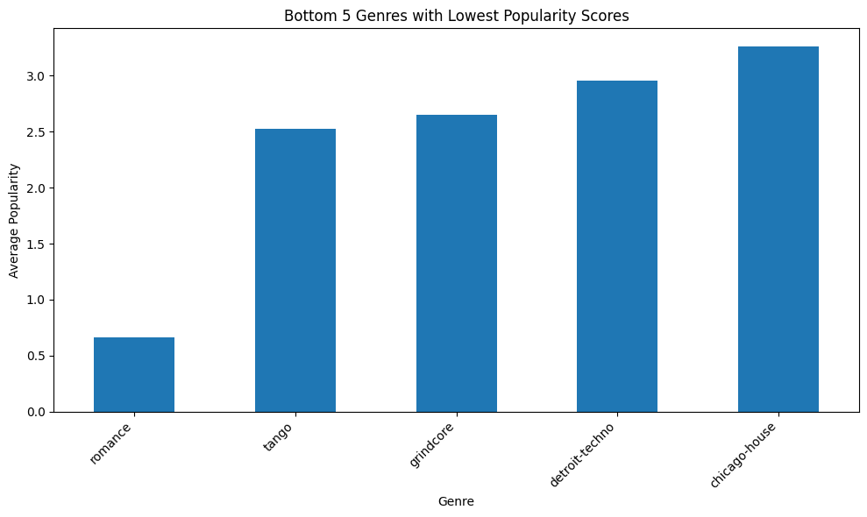
Q1.

Slide 8



Question Two:
What is the average popularity score relative to a songs release date?
What is the average popularity score for songs with a score of 85 or above relative to its release date ?
Exploring the average music attribute score per respective year

Slide 9
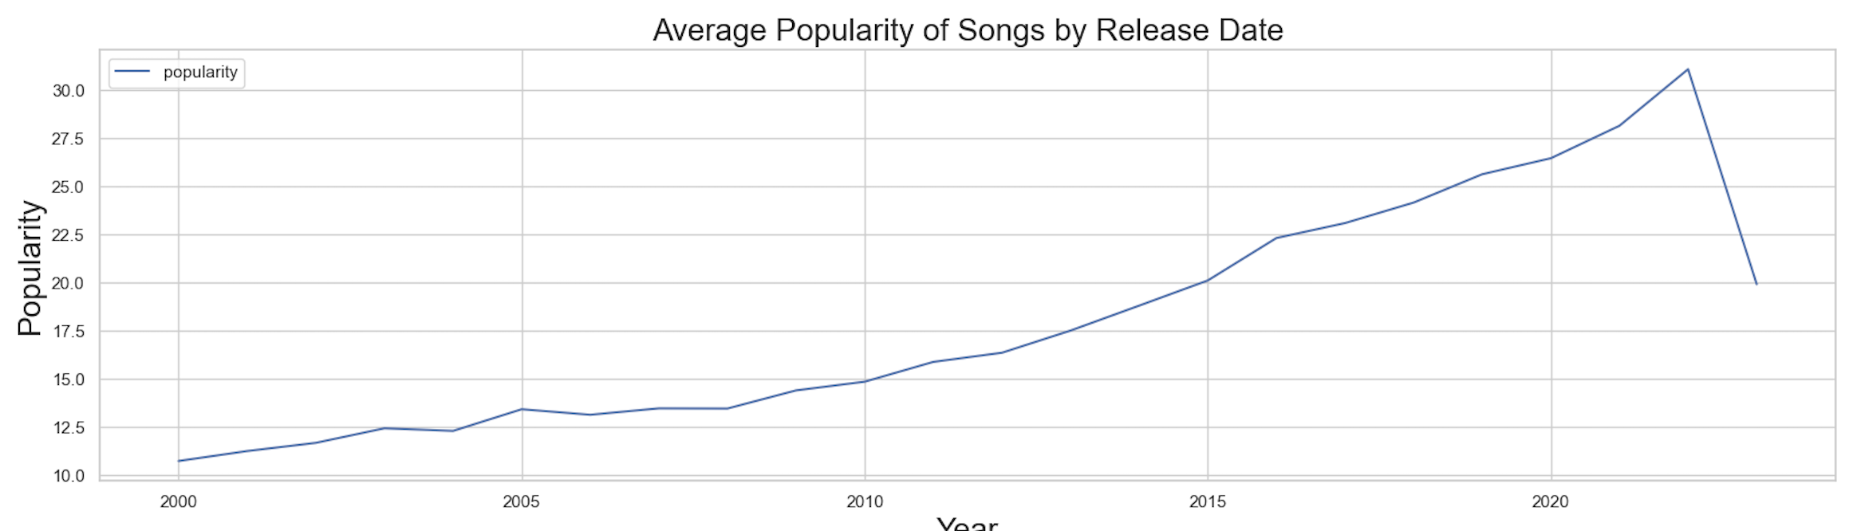
Q2.

Slide 10
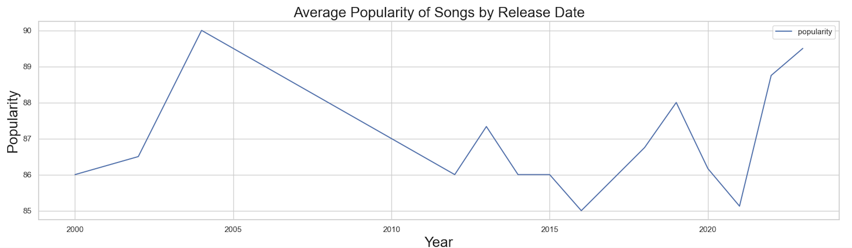
Q2.

Slide 11
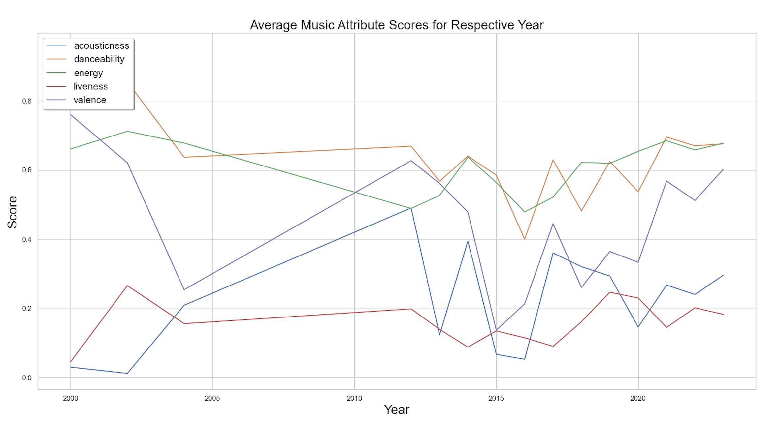
Q2.

Slide 12





Question 3:
Popularity Score vs. Danceability
Popularity Score vs. Energy
Popularity Score vs. “Instrumentalness”
Popularity Score vs. Liveness
Popularity Score vs. Duration

Slide 13
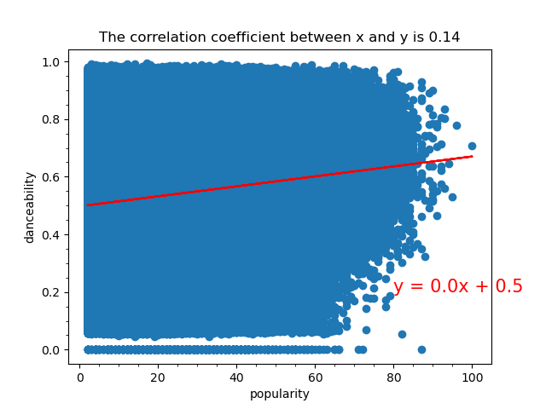
Q3.
Danceability

Slide 14
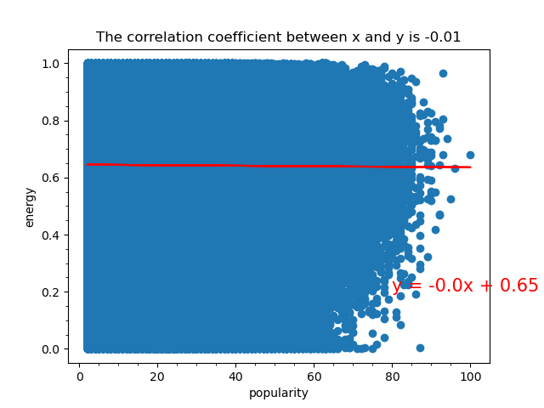
Q3.
Energy

Slide 15
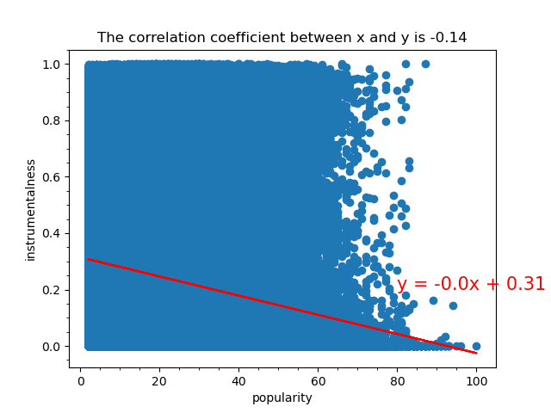
Q3.
“Instrumentalness”

Slide 16
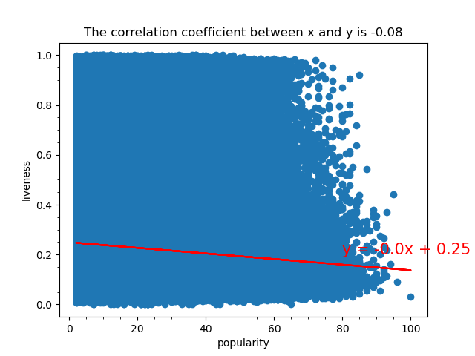
Q3.
Liveness

Slide 17
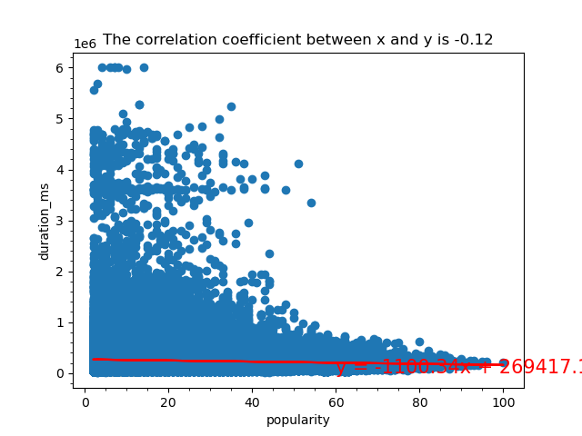
Q3.
Duration

Slide 18



Summary
Danceability Positively Effects Popularity Index
Recently released songs are more likely to have a higher popularity score
Pop, Hip-Hop, Dance are Most Popular Genres

Slide 19


Assessment and Evaluation
Spotify is One Platform
Consider Outside Factors

Slide 20

Thank you

